Slide 1
Data structure and Algorithm​ Lesson 7: Tree
Aj. Suttinee
Ref: CS1102 Lecture, SoC NUS

Slide 2
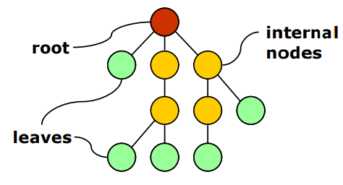
Tree

Slide 3
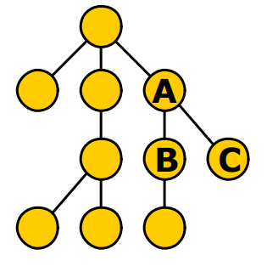
Relationship
A is parent of B and C
B and C are children of A
B and C are siblings

Slide 4
Relationship
D
E is uncle/auntie of BC
D is ancestor of ABCDE
B is descendant of ABD
E

Slide 5
Depth
depth
Length of path to the root
Depth of A is 1

Slide 6
Height
Length of path to the deepest leaf
Height of A is 2
height

Slide 7
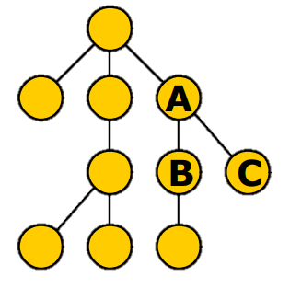
Size
Number of descendants
Size of A is 4

Slide 8
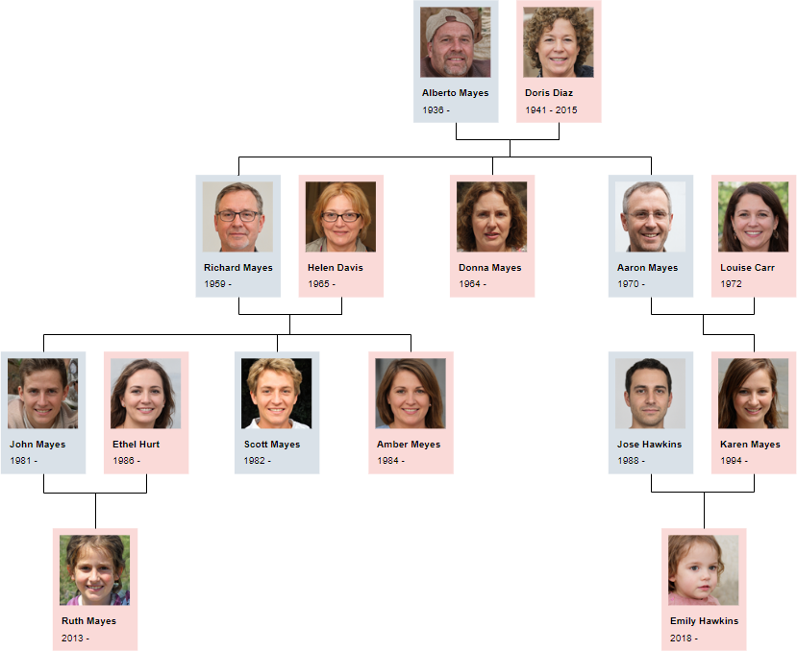

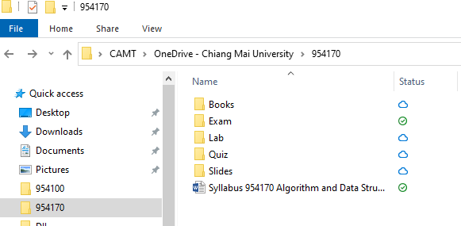
Applications
Family tree
Organization Chart
Directory tree

Slide 9
TreeNode class
D
public class TreeNode {
char element; TreeNode firstChild; TreeNode nextSlibing;
// methods …. public TreeNode(int data){ this.element = data;
this.firstChild = null; this.nextSlibing = null; }
}
F
E
G

Slide 10
TreeNode class
Element = D
firstChilde = Address of TreeNode F
nextSlining = NULL
D
public class TreeNode {
char element; TreeNode firstChild; TreeNode nextSlibing;
// methods …. public TreeNode(char data){ this.element = data; }
}
F
E
Element = C
firstChilde = NULL
nextSlining = NULL
Element = F
firstChilde = NULL
nextSlining = Address of TreeNode E
G
Element = A
firstChilde = Address of TreeNode B
nextSlining =NULL
Element = E
firstChilde = Address of TreeNode G
nextSlining = Address of TreeNode A
Element = B
firstChilde = NULL
nextSlining = Address of TreeNode C
Element = G
firstChilde = NULL
nextSlining = Address of TreeNode B

Slide 11
Binary Tree

Slide 12
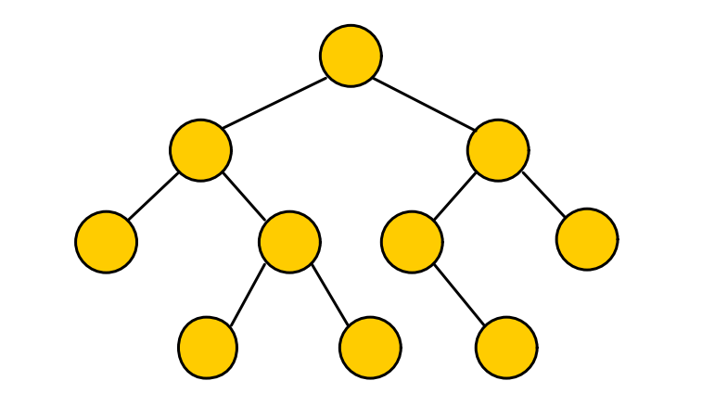
Binary Tree

Slide 13
Empty Binary Tree

Slide 14
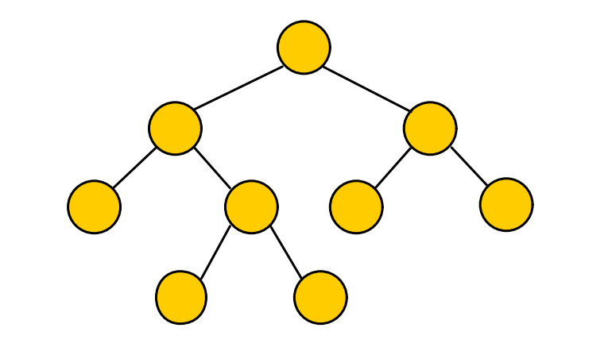
Full Binary Tree

Slide 15
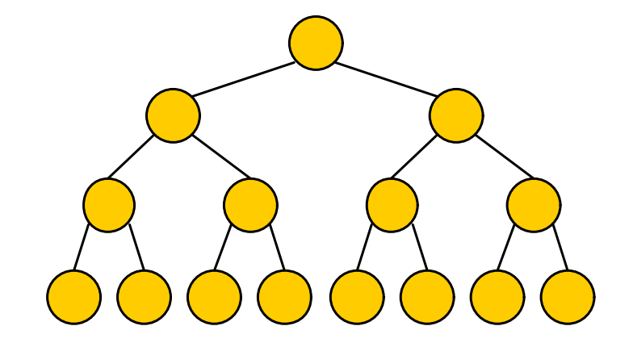
Complete Binary Tree

Slide 16
Property of Binary Tree
How many nodes in a complete binary tree of height 1 ?
How many nodes in a complete binary tree of height 2 ?
How many nodes in a complete binary tree of height 3 ?
How many nodes in a complete binary tree of height k ?
Number of node 2^{k+1} -1

Slide 17
BinaryTreeNode class
this.left = null; this.right = null;
1
public class BinaryTreeNode { int element; BinaryTreeNode left; BinaryTreeNode right; //methods... public BinaryTreeNode(int data){ this.element = data;
this.left = null; this.right = null; } }
8
6
3
4
2
7
9
5
0
Element = 1
Left = Address of BinaryTreeNode 8
Right = Address of BinaryTreeNode 6
Element = 7
Left = NULL
Right =NULL
Element = 4
Left = Address of BinaryTreeNode 9
Right = Address of BinaryTreeNode 5
Element = 2
Left =Null
Right = Address of BinaryTreeNode 0

Slide 18
To create a BinaryTreeNode
public static void main(String[] args) { BinaryTreeNode root = new BinaryTreeNode(1); }
public class BinaryTreeNode { int element; BinaryTreeNode left; BinaryTreeNode right; //methods... public BinaryTreeNode(int data){ this.element = data; } }
1

Slide 19
To create a BinaryTreeNode
public static void main(String[] args) { BinaryTreeNode root = new BinaryTreeNode(1);
a.root.left = new BinaryTreeNode(2); a.root.right = new BinaryTreeNode(3); a.root.left.left = new BinaryTreeNode(4); a.root.left.right = new BinaryTreeNode(5);
}

Slide 20
BinaryTree Class
public class BinaryTree { BinaryTreeNode root; public BinaryTree(int data) { this.root = new BinaryTreeNode(data); }
…
}
Inside this class, we want
a method to display the tree
A method to insert a new element

Slide 21
Binary Tree Traversal

Slide 22
Depth-first search (DFS)
DFS is technique used for traversing tree or graph
the deepest node is visited first
backtracks to it’s parent node if no sibling of that node exist
Preorder (Root, Left, Right)
Postorder (Left, Right, Root)
Inorder (Left, Root, Right)
1
8
6
3
4
2
7
9
5
0

Slide 23
DFS (Pre Order)
1
8
6
public void printPreOrder(BinaryTreeNode x) { if(x != null) {
System.out.print(x.element+" "); printPostOrder(x.left); printPostOrder(x.right); } }
3
4
2
7
9
5
0
Preorder (Root, Left, Right) 1,8,3,4,9,5,6,2,0,7

Slide 24
DFS (Post Order)
1
8
6
public void printPostOrder(BinaryTreeNode x) { if(x != null) { printPostOrder(x.left); printPostOrder(x.right); System.out.print(x.element+" "); } }
3
4
2
7
9
5
0
Postorder (Left, Root, Right) 9,5,3,4,8,0,2,7,6,1

Slide 25
DFS (In Order)
1
8
6
public void printInOrder(BinaryTreeNode x) { if(x != null) { printPostOrder(x.left);
System.out.print(x.element+" "); printPostOrder(x.right); } }
3
4
2
7
9
5
0
Inorder (Left, Right, Root) 3, 8,9,4,5,1,0,2,6,7

Slide 26
Breath-first search (BFS)
BFS is technique used for traversing tree or graph
BFS is Level order traversal of tree
1
8
6
3
4
2
7
1,8,6,3,4,2,7,9,5,0
9
5
0

Slide 27
Extra Code
public void insertPostOrder( int data) { Queue<BinaryTreeNode> q = new LinkedList<>(); q.add(root); while(q != null){ BinaryTreeNode temp = q.remove(); if(temp.left == null) { temp.left = new BinaryTreeNode(data); break; } else{ q.add(temp.left); } if(temp.right == null) { temp.right = new BinaryTreeNode(data); break; } else{ q.add(temp.right); } } }

